Slide 1
Driving Performance Analyzer Patrick Chen Zheng Zhao Weijian Li Yijie Chen Jingya Xun

Slide 2
Motivation
There’s no objective metric to measure driving behavior right now
Example:
- Driving tests are executed in a subjective manner (instructors, examiners)
- Insurance companies have trouble determining a new customer’s driving skills and thus their insurance fee quote

Slide 3
Data Collection & Analysis
Micro Bit
- used as an accelerometer
- Matplotlib to plot the real time acceleration change
- Numpy to calculate standard deviation
Vision
- Camera and OpenCV
Lego Car (developed previously)
- a toy model simulating a real life scenario
- color sensor
Raspberry Pi – process data collected by Micro Bit. For this prototype, we are using a MacBook Pro due to computational requirements and connection problems

Slide 4
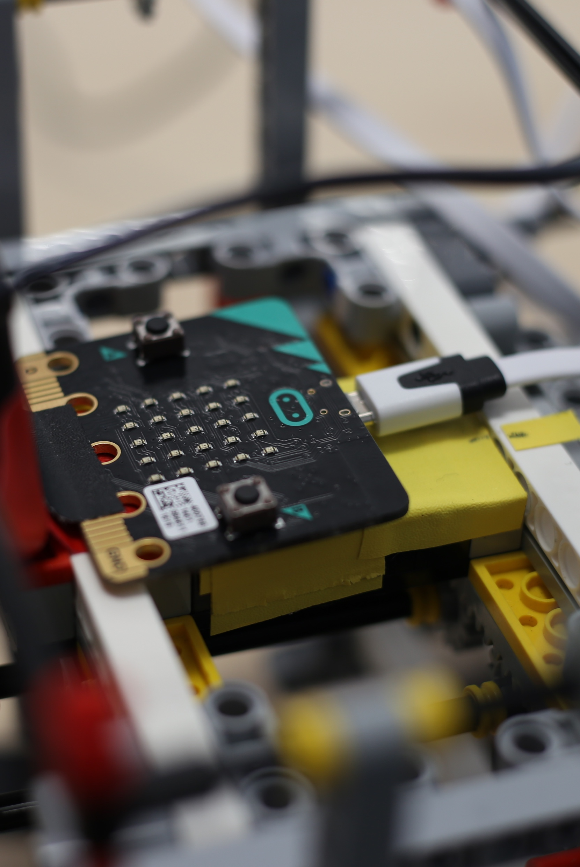
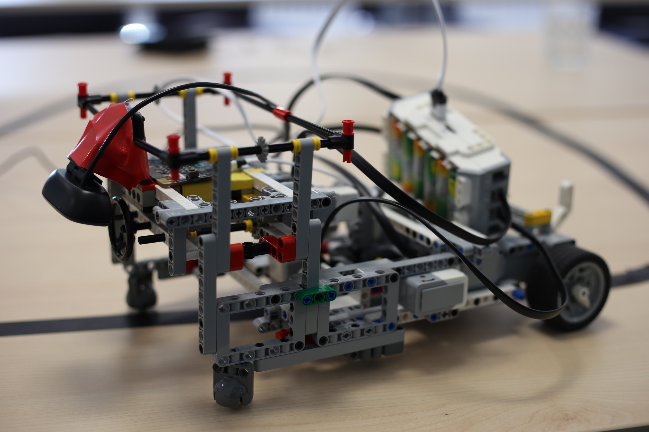
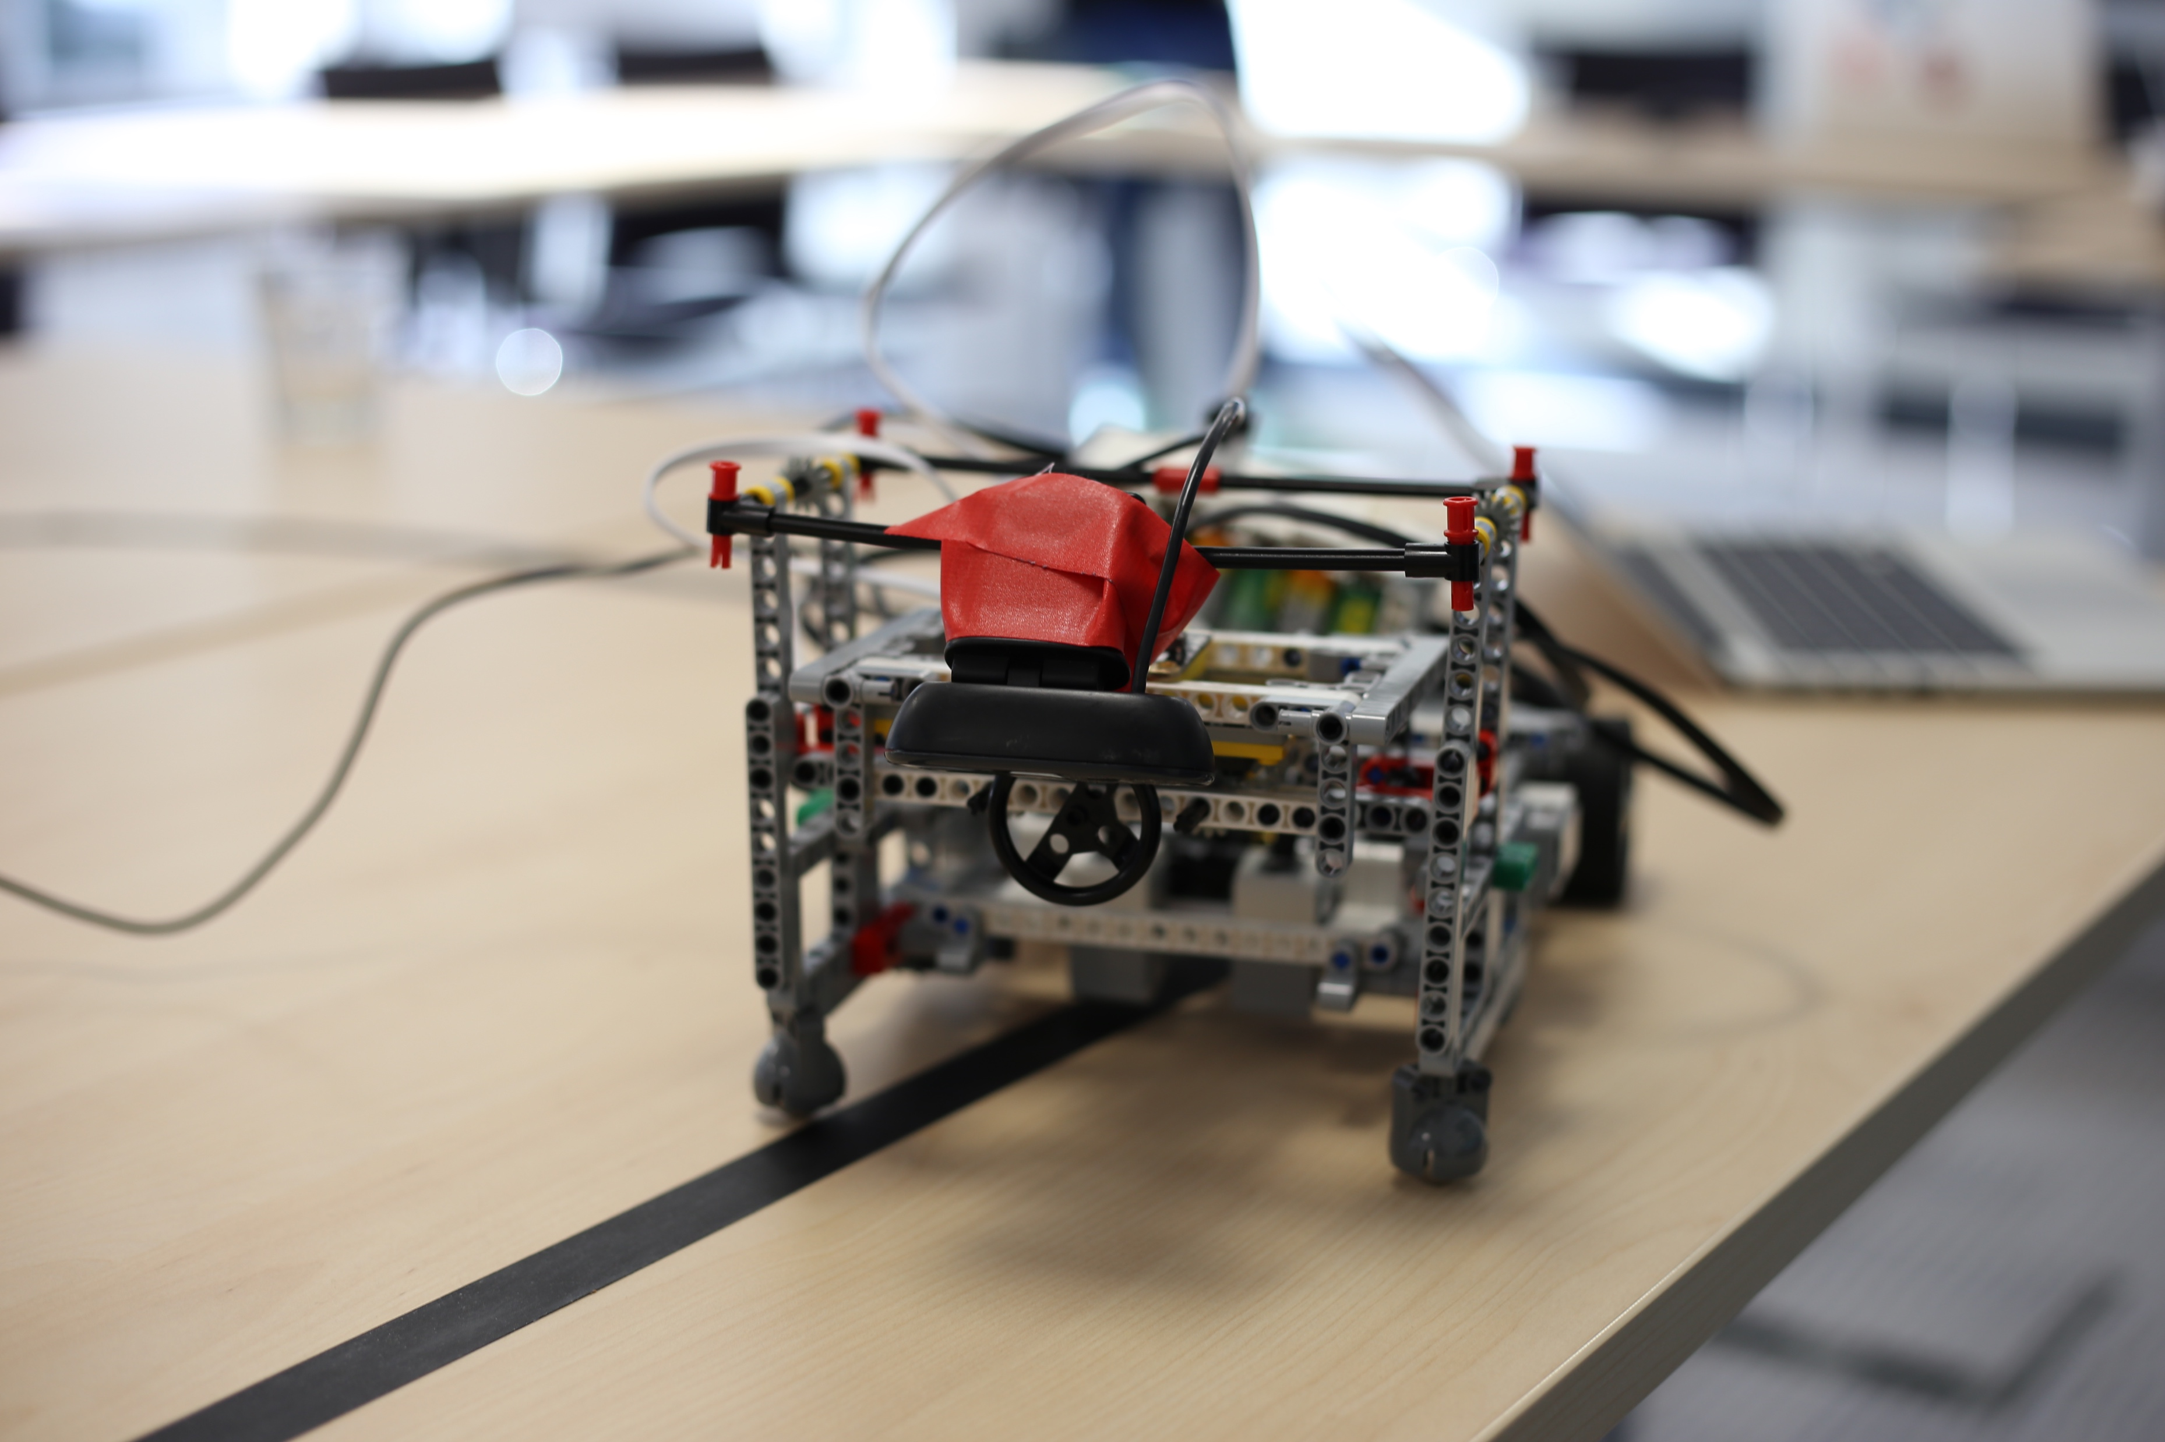

Slide 5
Future Application
Auto-driving algorithms
AI driving instructors
Insurance quotes

Slide 6
Thank you

